Slide 1
SMART Ritual Abuse and Mind Control Online Conference August 10-11, 2024
TRACES OF MASONIC RITUAL ABUSE IN
CARL JUNG’S RED BOOK AND BLACK BOOKS
Dr Lynn Brunet
“I got into the dark, and I groped along my path.”
(C. G. Jung, Black Book 2, p. 149)

Slide 2
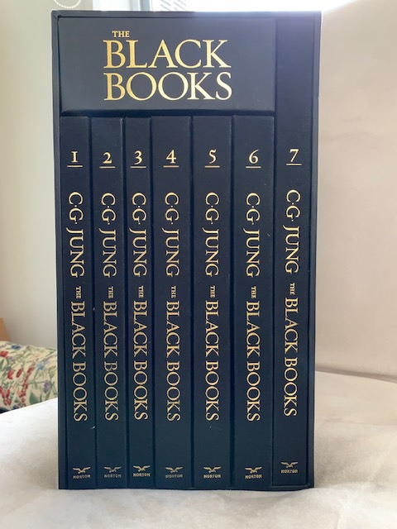
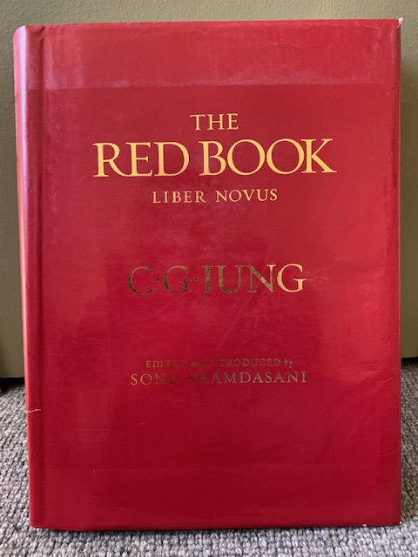
C. G. Jung (1875-1961)
C. G. Jung, The Black Books 1913-1932: Notebooks of Transformation, edited by Sonu Shamdasani. W. W. Norton & Co, 2020.
C. G. Jung, The Red Book: Liber Novus, edited by Sonu Shamdasani.
W. W. Norton & Co, 2009.

Slide 3
The overall thesis of my 2018 study, Answer to Jung: Making Sense of The Red Book, is that all of Jung’s fantasies are remarkably similar to some of the Masonic rites used in Switzerland during Jung’s childhood and youth, although they appear to be distorted or abusive versions.
In 1907 Jung told Freud that he had been sexually assaulted as a boy; my study concludes that he may have also been ritually abused.
In the Black Books, published in 2020, Jung presses his soul to provide a glimpse into what all of these fantasies and experiences are about. She answers with a series of questions:
“Temples in deserts? Secret societies? Ceremonies? Rituals? Colorful robes? Golden images of Gods of terrible aspect?”
Jung, Black Book 6, p. 268

Slide 4
C. G. JUNG’S FAMILY BACKGROUND Paternal grandfather, Carl Gustav Jung (1794-1864) – an ardent Freemason and a Grand Master of the Grand Lodge Alpina of Switzerland. An uncle, Ernst Karl Jung (1841-1920) – also a Grand Master of this Grand Lodge.
C. G. JUNG’S CHILDHOOD
Father, Paul Achilles Jung (1842-1896) – a Protestant clergyman. Jung exposed to the reality of death from an early age.
At the age of 3 or 4 he had a terrifying dream where he was taken into a Secret Vault where there was a large object, which he later understood to be a ritual phallus.
As a young person he felt that he had two different personalities: No. 1, the ordinary schoolboy, and No. 2, the one who inhabited this private other world.

Slide 5
“Only in the first hour of the night can I become human, while the male dove is busy with the twelve dead.” Jung, Black Book 2, p. 156
Count Cagliostro’s Egyptian Rite
Crystal-gazing/hypnosis
Children were involved in the Masters degree of this rite

Slide 6
“My soul leads me into the desert, into the desert of my own self. I did not think that my soul is a desert, a barren, hot desert, dusty and without drink. The journey leads through hot sand … Why is my self a desert?”
Jung, Black Book 2, pp. 163-164

Slide 7
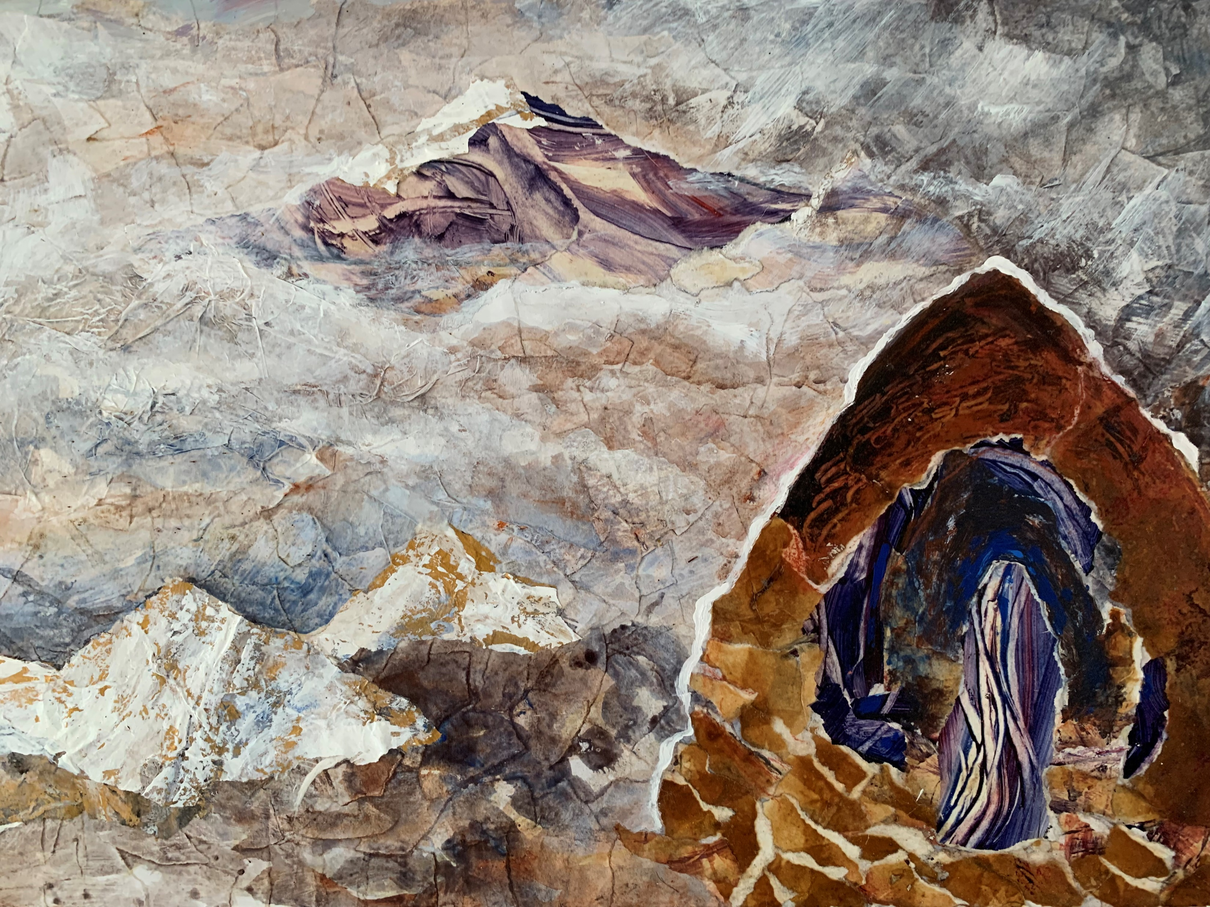
“Forgive my astonishment, am I truly in the underworld?”
Jung, Black Book 2, p. 180
Artwork by Lynn Brunet

Slide 8
“(I obey – no resistance)”
“(Now it gets difficult)”
“(frightful - but it must be)”
“(disgusting - survived)”
“ice-cold hands of steel murderously grasp after you”
“one would like to slobber over you in heat”
Jung, Black Book 2, pp. 177, 179.

Slide 9
“I see the cross and Christ on it in his last hour and torment … I stand with outstretched arms like someone crucified, my body taught and horribly entwined by the serpent: ‘You, Salome, say that I am Christ?’ … The serpent squeezes my body in its terrible coils and the blood streams from my body, spilling down the mountainside … My feet do not touch the ground of this earth, and it is as if I were melting into air.”
Jung, The Red Book, Reader’s Edition, pp. 197-198
“But I am back in front of the crystal, still in the same position.”
Jung, Black Book 2, pp. 196

Slide 10
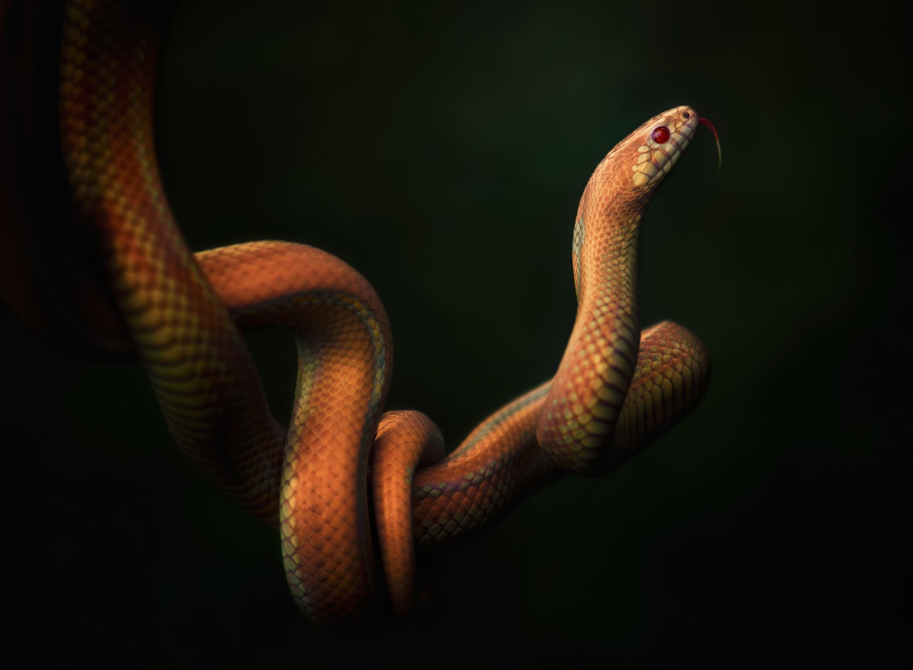
“All this is Mithraic symbolism from beginning to end.”
Jung, The Red Book, Reader’s Edition, p. 197, note 211
Birth of the god Mithras in Jung’s soul
Sage of Mithras degree
Children of the male sex thought to have been initiated long before they reached maturity

Slide 11
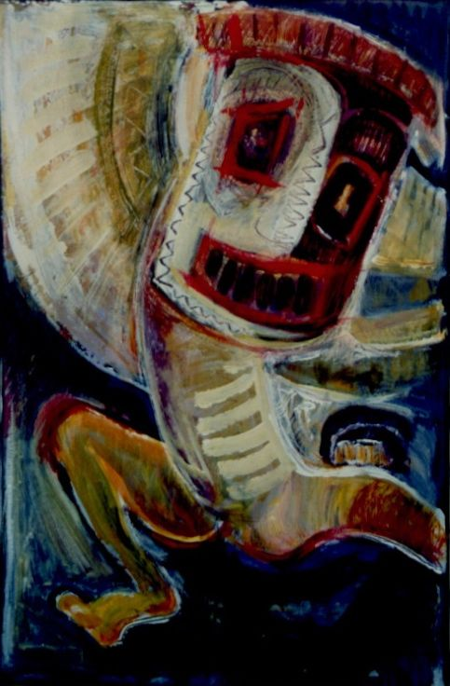
Death
“… I perish on a dung heap, while peaceful chickens cackle around me … mindlessly laying their eggs. A dog passes, lifts his leg over me, and trots off calmly. I curse the hour of my birth seven times, and if I do not choose to kill myself on the spot, I prepare to experience the hour of my second birth ... For three nights I was assaulted by the horrors of birth. On the third night, junglelike laughter pealed forth … Then life began to stir again.”
Jung, The Red Book, Reader’s Edition, p. 268
Artwork by Lynn Brunet

Slide 12
“The vision that I did not want to see, the horror that I did not want to live.”
Jung, The Red Book, Reader’s Edition, p. 320

Slide 13
“As a psychiatrist I became worried, wondering if I was not on the way to ‘doing a schizophrenia’. ” Jung, The Red Book, Reader’s Edition, p. 28
Early in his career Jung worked with Pierre Janet
So he was exposed to the concept of trauma-related dissociation and the splitting of the psyche during traumatic experience
Other psychoanalytic theories of the time included ‘projection’ and ‘introjection’
Jung used the term ‘projection’ quite a lot, but he replaced the term ‘introjection’ with his own term, ‘the shadow’.

Slide 14
“Once I adored you, then I loved you, now you threaten to become contemptuous to me. You seem to me dull ... you blabber only to yourself, and go round in circles.” Jung, Black Book 5, pp. 210–211
Jung’s soul
Go to hell, you old cocotte! …Concubine of heaven … Divine monster
Wick daimon …Gruesome devil …My soul … I shudder at you
My soul - yes, you are the devil ... My soul, you separated doubleness
Someone who calls himself your soul ... putting on a reckless show
My soul, mother of wisdom, answer me!

Slide 15
Perpetrator Introjects
Alison Miller states: “introjects (internal copies) of abusers are common in dissociative disorders.” In mind control, she says, “many perpetrators put their own stamp on to a personality system by putting ‘themselves’ inside it”… often during a rape; and then convince these alters that they are the perpetrator. (2012, pp. 45–46, 51–52)
Ralf Vogt defines perpetrator introjects as related to “man-made traumatic experiences, which become internalised through dissociative processes … [and] to be complex psychological models, that we were forced to take in early in life because our boundaries were violated by an aggressor.” (Cited in Vogt, 2018, p. 3).
Ellen Lacter describes these strategies used by perpetrators as “calculated, psychologically-sophisticated, dissociation-savvy abuse.” (2021).

Slide 16
Brain discoveries relevant to trauma, memory and introjection
Jim Davies, Imagination: The Science of Your Mind’s Greatest Power, 2019.
In 1994 – the discovery that there were specialised cells in the brain’s frontal lobes that related to the quality of empathy; they became known as mirror neurons (van der Kolk, 2014, p. 58).
In 2007 – the discovery that the brain network which underlies memory is also the same one utilised by the imagination (Schacter et al, 2012, p. 677; Davies, 2019).
The act of remembering is automatically an act of imagination – memories are reconstructed every time they are retrieved.
Real memories and make believe – Real memories tend to be more vivid that make believe and here van der Kolk (2014) explains the important role adrenaline plays, especially if the event is a terrifying one. The more adrenaline released, the more accurate the memory.
In Jung’s case – the experience of believing that he had eaten the liver of a dead child would qualify as highly adrenaline-releasing.

Slide 17
Introjection from a literary perspective
Jung could be classed as hyperphantasic, someone whose mental images are extremely detailed, vivid or accurate (Zeman, 2016, cited in Davies, 2019, p. 15).
Jung’s extremely detailed imagery, described both verbally in his journals and visually in his paintings, along with his professional position as a psychiatrist and leading figure in the early psychology movement, suggests that his fantasies need to be taken seriously.
Davies (2019) suggests that fiction writers may be able to tell us something about how their characters can take on a life of their own. For example, Alice Walker who wrote The Color Purple.
The concept of automatization as it is applied to fiction writers.
The concept of automatization in the development of Jung’s inner characters.

Slide 18
Jung’s key inner characters/alters and minor ones
KEY INNER CHARACTERS: Jung’s soul, who takes center stage, Philemon, Ammonius, the prophet Elijah and Salome.
MINOR CHARACTERS: the spirit of the depths, the hero Seigfried, a serpent, the Red One, an old scholar and his beautiful daughter, a tramp, the giant Izdubar, Ha the black magician, the librarian and the cook, Ezekiel, characters from the Grail legend, Philemon and Baucis, the dwarfish elemental spirits known as the Cabiri, a hanged man, a raven, a shade who commands him to drink blood from a carcass, the dead who comprise the audience for the Seven Sermons, an old doctor in a turban, and a blue shade identified as Christ.

Slide 19
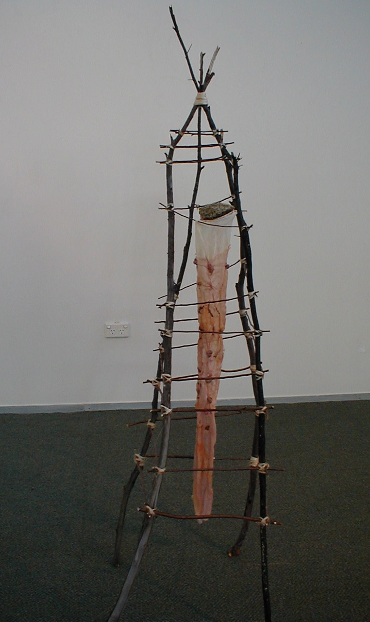
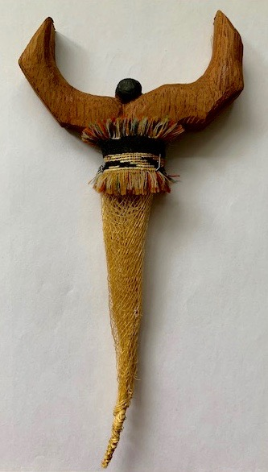
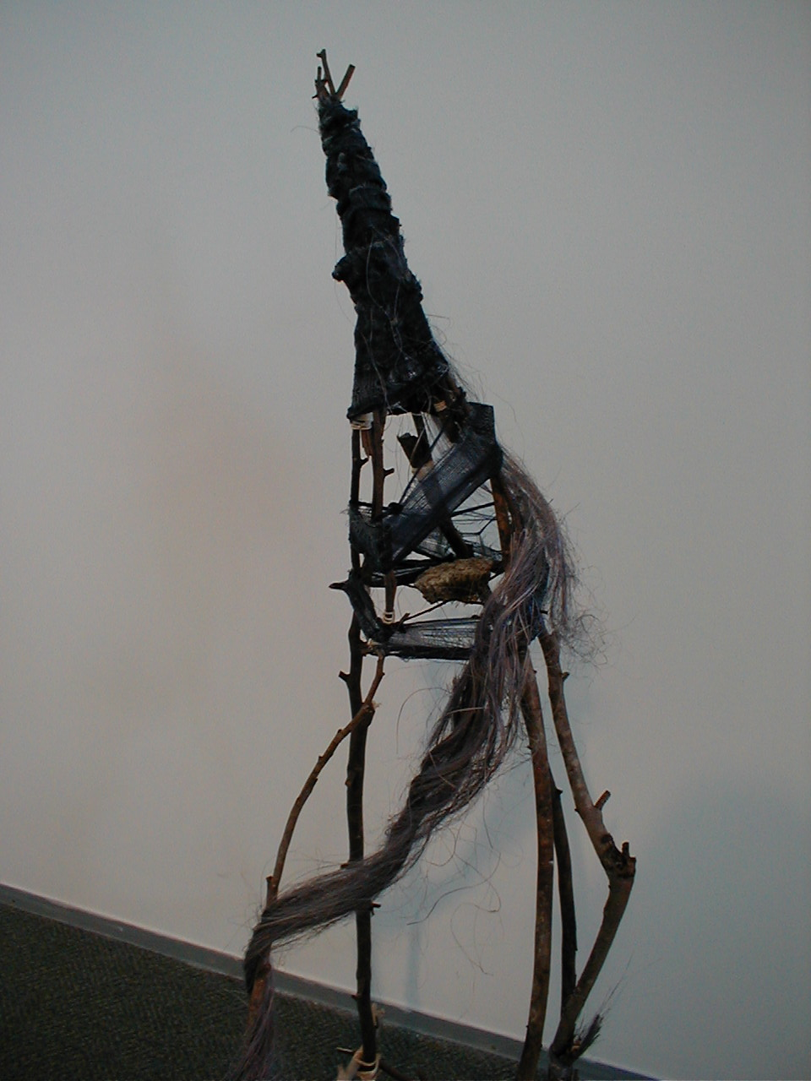
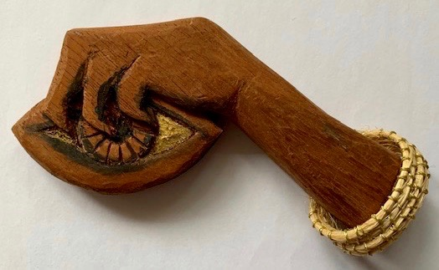
“I warned you about magic. Devilish stuff gets into you.” Jung, Black Book 6, p. 263
Artwork by Lynn Brunet

Slide 20
“But what is my calling? The new religion and its proclamation.” Jung, BB 7, p. 211

Slide 21
“I have … prepared all of the instruments of the torture chamber for you, if it should ever occur to you again to be sensitive.” Jung, Black Book 5, p. 223

Slide 22
“Like a stray child you stand pitifully among the mighty, who hold the threads of your life. You cry for help and attach yourself to the first person that comes your way. Perhaps he can advise you, perhaps he knows the thought that you do not have, and which all things have sucked out of you.” Jung, The Red Book, Reader’s Edition, p. 260.
Manipulated attachment needs
Jung’s realisations in the Black Books
Background images sourced from Powerpoint stock images. Other artwork
by Lynn Brunet.

